Slide 1
Cloud Resource Management Tools
Open Stack

Slide 2
OpenStack
OpenStack is the framework for building a cloud operating system, an open source project designed to provide software for the construction and management of public and private clouds, comprising a large number of peripheral components, integrating and managing a wide range of hardware devices, and hosting a variety of upper-level applications and services, resulting in a complete and robust cloud computing system.
deploying infrastructure as a service (IaaS), or building a complete framework for a cloud operating system.

Slide 3
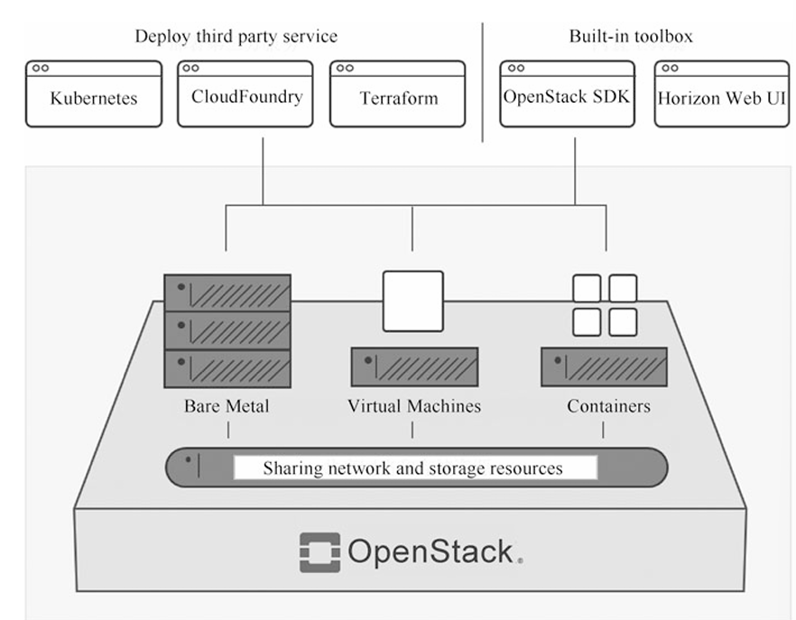

Slide 4
Openstack as OS Framework and not OS
OpenStack cannot independently implement resource access and abstraction, but needs to work with the underlying virtualization software, software definition storage, software definition network, and other software.
cannot independently provide comprehensive application life cycle management capabilities but needs to integrate various management software platforms at the upper level.
does not have complete system management and maintenance capabilities, and when put into use, it needs to integrate various management software and maintenance tools.
OpenStack's human–machine interface is not rich, powerful, etc.

Slide 5
OpenStack Core Components
Nova
Controller to support all processing of life cycle of instances within OpenStack, and manage and scale requirements.
Can not provide virtualization and use LibVirt API to support interaction between hypervisors.
Swift
Provide Object Storage Services, which allow files to be retrieved. Not mounting.
Provides consistent virtual object storage.
Highly scalable, can store billions of objects with distributed storage nodes, has built in fault management, archiving , streaming capabilities.
Glance
Provide directory and storage for virtual disk images. The disk images are used in Nova component.
Perform mirror management.
Keystone
Provide authentication and authorization for all services on Openstack. The most critical component in openstack.
Neutron
Core component to provide network services. Use SDN, software based network resource management and various network related technologies in Linux OS to support third party plug-ins.
Cinder
Virtual component, store the disk files and data used by VM.
Provides block storage services for instances,
Block storage Drives determine the allocation and consumption of storage.
Horizon
Horizon provides a Web-based interface that enables cloud administrators and users to manage a variety of OpenStack resources and services.

Slide 6
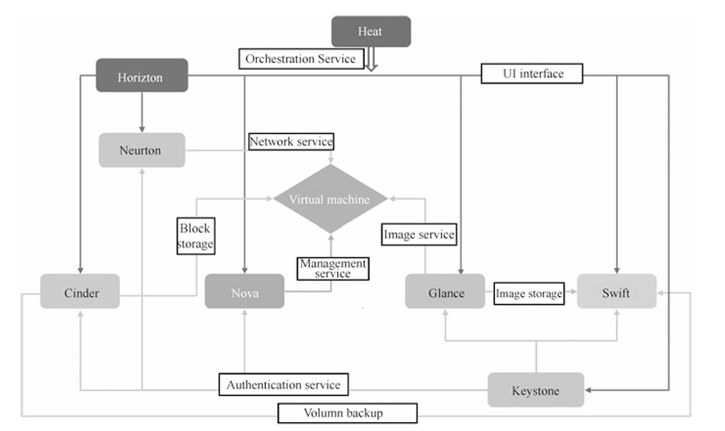
The logical relationship between OpenStack components

Slide 7
Logical Relationship Between OpenStack Components
OpenStack's services are called through a unified REST-style API to achieve loose coupling of the system.
What is loose coupling architecture?
loosely coupled architecture also brings some difficulties to maintaining the whole system, and operations personnel need to master more system-related knowledge to debug the components that are in trouble.
developers and maintenance personnel must understand the interchange relation ships between components.

Slide 8
Open source and proprietary or closed source
What is this ?

Slide 9
Eucalyptus Cloud as IaaS
IaaS Style is private and hybrid clouds.
Infrastructure resources (machines, network and storage )
Implemented inside existing data center
Implement industry standard AWS APIs.
Provide own set of command line tools (Euca2ools):internal and external
The main components are Cluster controller , cloud controller, Node controller, walrus storage controller and storage controller

Slide 10
Eucalyptus Components
Cluster Controller(CC): manage NCs, manage , communicate between controllers, and manage networks specific instances
Cloud Controller (CLC): front end, provide EC2/S3 interface
Node Controller (NC): basic component of node, maintains instance on each nodes, interact with OS, Hypervisor and CC
Walrus Storage (WS3): file storage system, such as machine image, snapshots,
Storage Controller (SC): provide persistent block storage and allows creation of snapshots of volumes.

Slide 11
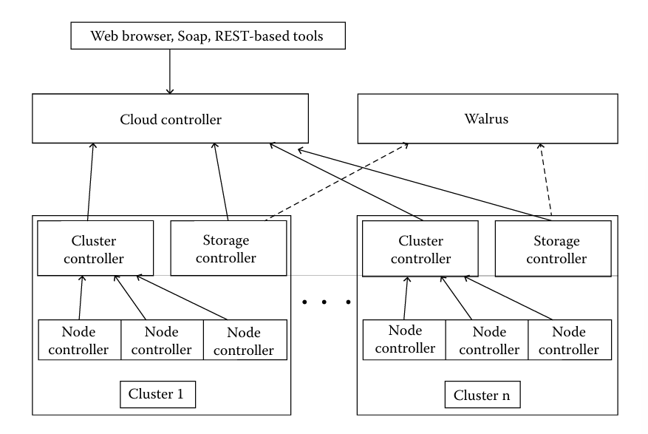

Slide 12
More Open Source Iaas
OpenNebula
Apache CloudStack: good for large networks of vms
Nimbus: good in terms of administration of Virtual networks, as it is supported by SSH into all nodes

Slide 13
OpenSource PaaS
Paasmaker: provide full visibility to users, actions are broken into trees format to be monitored, portable with PHP, Ruby, python, Nodejs, designed for clusters. (distribution and cluster failure )
Red Hat Openshift: broker, node servers.
Broker is single point of contact for all application management activities(login, DNS, application state, orchestration of application.)
Node server has built-in cartridges and gears. Where user application is stored and served

Slide 14
OpenNebula Scheduler Module
An algorithm that places Virtual Machine depending on their requirements.

